Slide 1
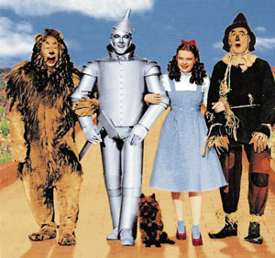
The Wizard of Oz:
A Parable for Populism?
Based on the analysis by Henry M. Littlefield

Slide 2
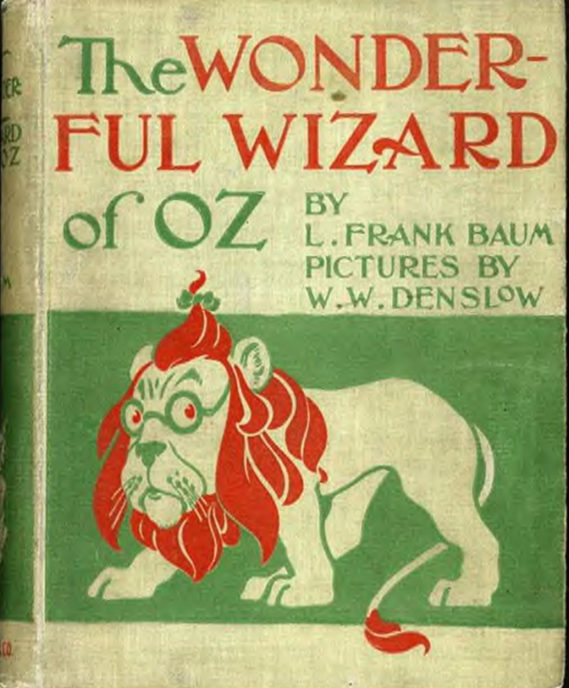
The story
In 1900, L. Frank Baum published a children’s story called The Wizard of Oz. You’re probably familiar with the 1939 movie of this story in which a girl named Dorothy finds herself in a fantastical world where she must follow a yellow brick road to speak to the Wizard of Oz. On the way she befriends a brainless scarecrow, a heartless tin man and a cowardly lion. Together they find the wizard, defeat the Wicked Witch of the West and each finds what he was looking for.
In 1964, Henry Littlefield published a thesis asserting that the story was an allegory for the politics of the 1890s, especially the debate over gold and silver coinage. His ideas have led to much speculation.

Slide 3
The Wizard of Oz could have been used as populist propaganda. While Baum was a populist, neither he nor his family ever claimed that the Oz stories were anything but fantasy. He claimed he got the name “Oz” by merely glancing at a file cabinet drawer.

Slide 4
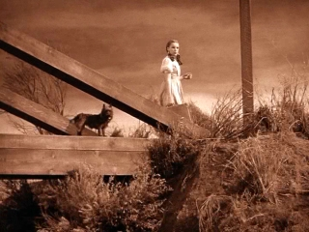
The life of a farmer
In the book, Dorothy’s life on the farm is dark and dreary, a lot like the hard life on the Plains at this time, subject to drought, depression, falling prices, mounting debts, foreclosures, the feeling of being abused by railroads, etc. In the movie, Kansas is sepia-toned, washed out.

Slide 5
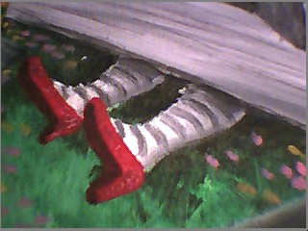
Evil Rules the East and the West
Dorothy is taken to Oz on a tornado, a common symbol in the 1890s for political upheaval and revolutionary change.
Her house lands on and kills the Wicked Witch of the East, who represents the evil bankers and the wealthy Eastern establishment.

Slide 6
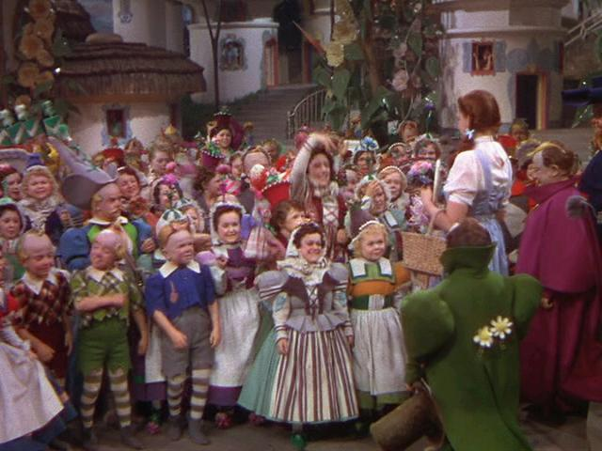
The Munchkins
The Munchkin people were under the power of the Wicked Witch of the East.
The Munchkins represent the eastern industrial laborers under the control of rich leaders of industry, beaten down and shrunken. May also be comment on child labor (Lollipop Guild)

Slide 7
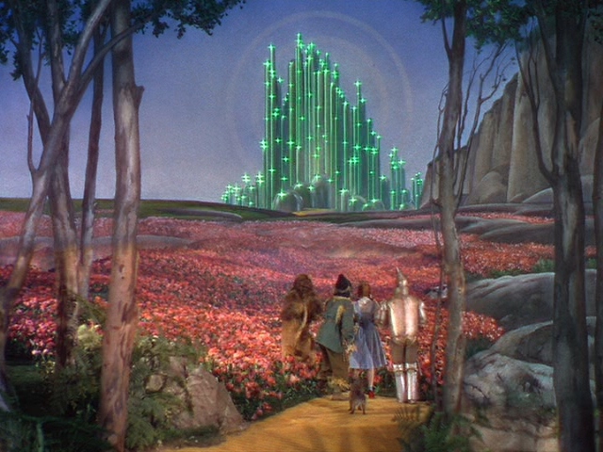
The Land of Oz
A magical and beautiful place, of illusion.
In the North and South, people are ruled by good witches
A yellow brick road (the gold standard) leads to the Emerald City (Washington D.C.)
In the book, the city is bland white, and all who enter must put on Emerald colored glasses.
Green is also the color of money “Greenbacks” – printed to increase the amount of money in circulation

Slide 8
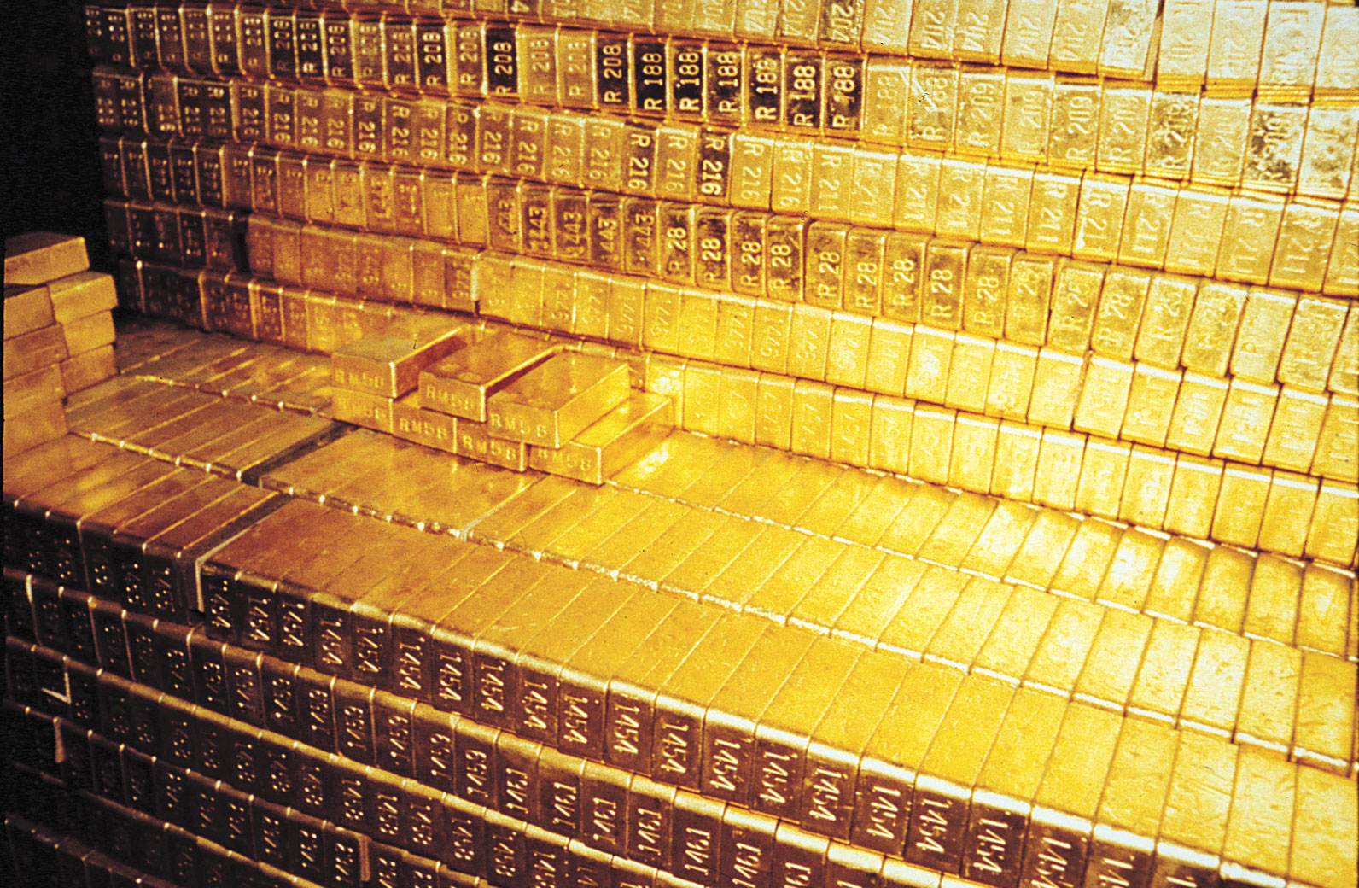

OZ

Slide 9
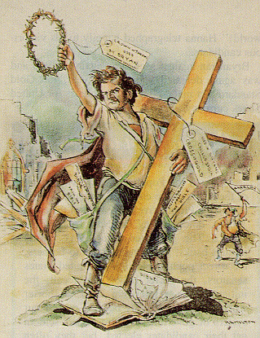
Demand for Silver Coinage
Populists demanded silver coinage instead of gold because it would create a larger money supply and loosen credit
Populist presidential candidate, William Jennings Bryan, made the famous “Cross of Gold” speech in 1896

Slide 10
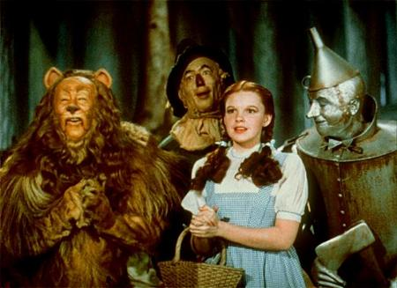
Dorothy
Dorothy represents the common man
From Kansas, center of Populist movement
May be inspired by Mary Ellen Lease, prominent Populist leader
She is good and levelheaded
She has problem and doesn’t know how to solve it

Slide 11
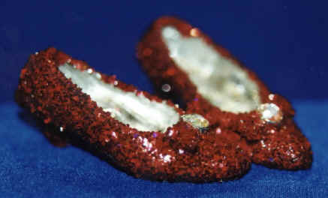
Silver, not Ruby Red Slippers
Dorothy is sent to see the wizard
In the book, she is given silver slippers to protect her; they’re red in the book to take advantage of new color film technology.
And, she must take the Yellow Brick Road
She doesn’t realize until the end that the power to get home was with her all along—all she had to do was click her shoes 3 times and wish herself home

Slide 12
Likewise, farmers and laborers didn’t understand the power of silver. They couldn’t organize well enough to defeat the gold standard.

Slide 13
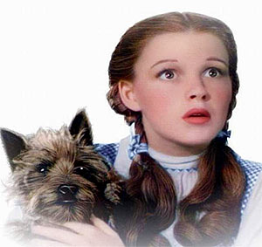
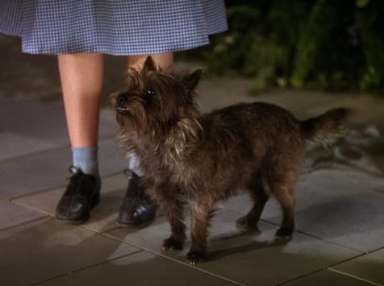
Toto
Toto represents the Prohibition & Temperance parties
“Teetotaler” – one who abstains from alcohol
Prohibitionists were political allies of the Populists

Slide 14
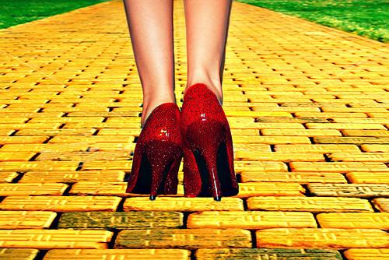
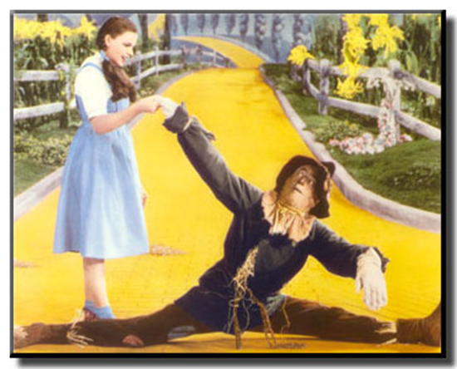
Yellow Brick Road
The Gold Standard.
The Populists believed that the gold standard, like the yellow brick road, had many pitfalls for ordinary people.

Slide 15
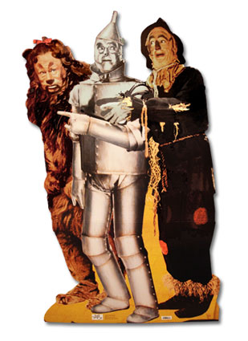
Dorothy is accompanied by three companions:
The Tin Woodman
The Scarecrow
The Cowardly lion

Slide 16
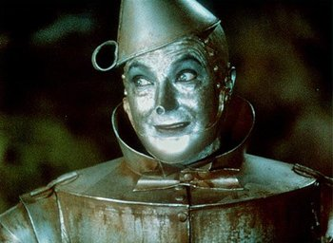
The Tin Woodman
Once he was an independent and hard working human being
Under the spell of the Wicked Witch of the East, the Woodman found that every time he swung his axe he chopped off a different part of his wooden body. (dangers of workplace?)
Eventually, he was patched up with tin

Slide 17
Tin Woodman
“In this way Eastern witchcraft dehumanized a simple laborer so that the faster and better he worked, the more quickly he became a kind of machine.”
—Henry Littlefield
The Tinman rusted stiff and couldn’t move just like the eastern laborer had no way out of his terrible condition.
His rusty joints had to be lubricated. (importance of Standard Oil?)

Slide 18
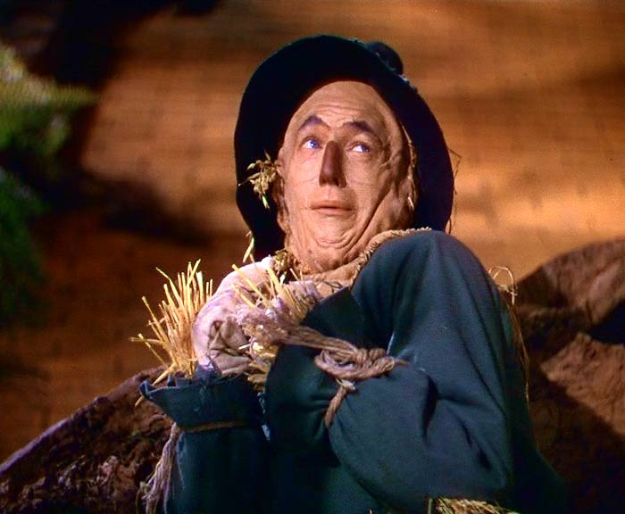
The Scarecrow
Shows the stupidity of farmers who were once enlightened, shrewd, and capable; but, now stood powerless in the face of industrialization.
Prejudiced notion that farmers were ignorant and not smart enough to recognize their own interests and felt too intimidated to enter the realm of politics.
Not respected, not even by the crows. Dorothy tells him to wake up!

Slide 19
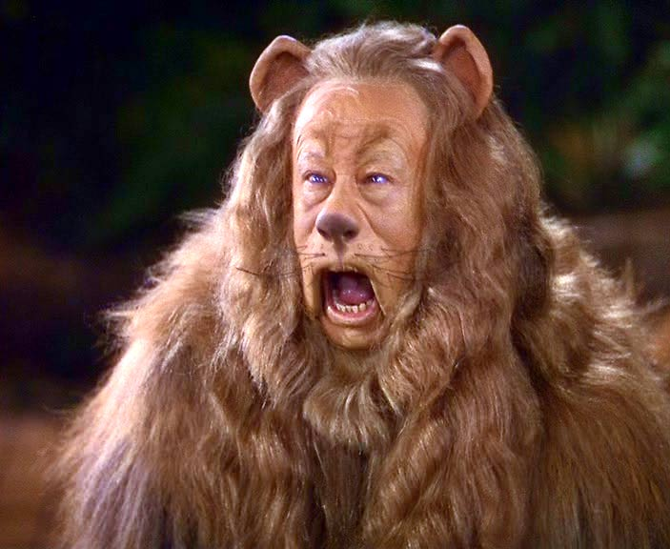
The Cowardly Lion
Roared loudly, but no one was scared of him
Believed he needed courage
William Jennings Bryan may have been a great orator, but despite his roar, he had no REAL power. “All bark & no bite.”
He didn’t have the power to get it done.

Slide 20
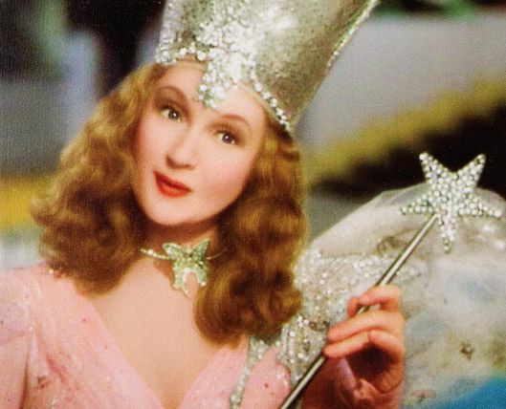
The Good Witches
Glinda is the Good Witch of the North in the movie, South in the book
Represents Northern & Southern Farmers Alliances:
(The Farmers Alliances created the Populist Party)
Political power is like witchcraft…some use the power for good, some for evil purposes.

Slide 21
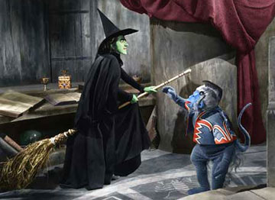
The Wicked Witch of the West
Dorothy ends up fighting the Wicked Witch of the West
The Wicked Witch can represent the railroads or mother nature
The flying monkeys are the Native Americans; savage, and childlike they can (negative stereotype)
be both good and bad, easily swayed; once free in the forests till Oz came to rule
The witch is defeated by water, the most valuable western commodity, ender of droughts

Slide 22
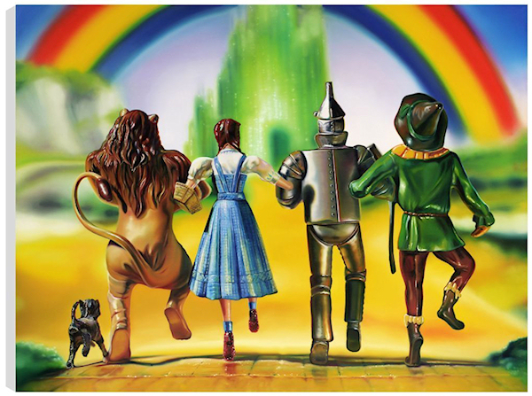
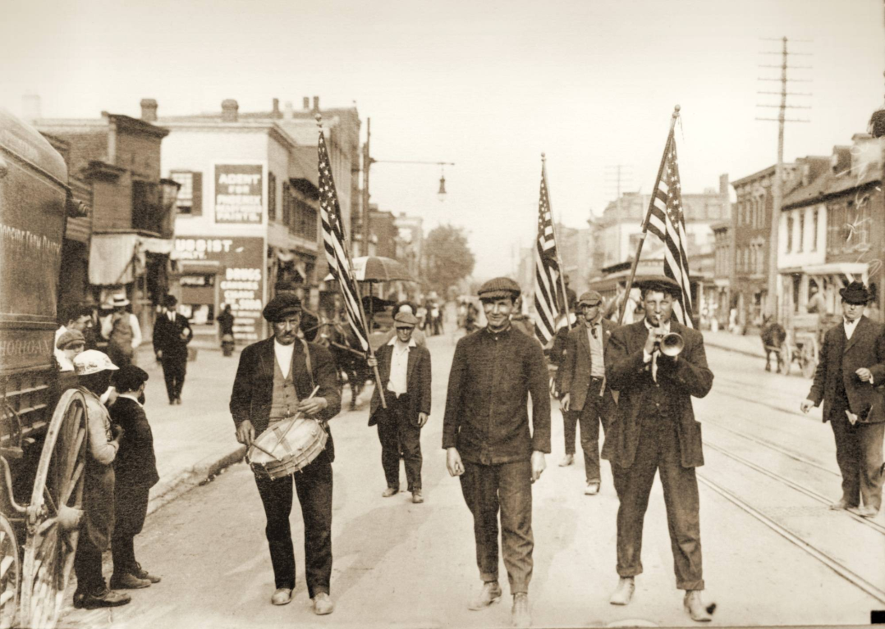
We’re off to see the Wizard
Inspired by Coxey’s Army of unemployed who marched to Washington in 1893-4, demanding relief from the government

Slide 23
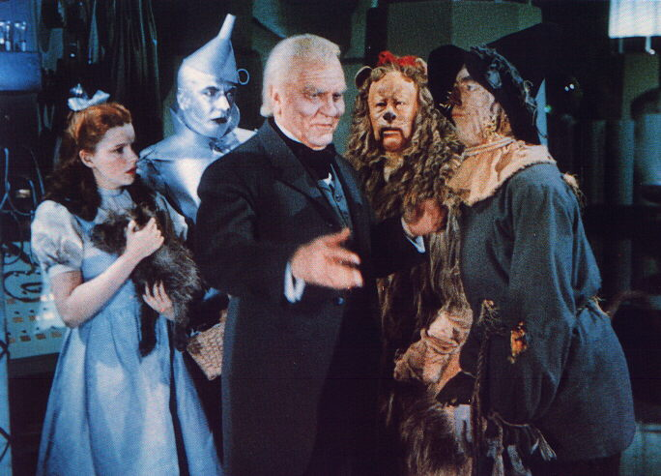
The Wizard of Oz
The Wizard lives in the Emerald City and is powerless; his powers are an illusion
He represents any president from Grant to McKinley.
These presidents were fairly unimpressive and did the bidding of the rich

Slide 24
The Wizard
Gilded Age Politicians:
In the book, the Wizard appears to be a giant head to Dorothy, to the scarecrow, a gossamer fairy, to the Tin Man as a beast and to the Cowardly Lion as a ball of fire…just as politicians try to be all things to all people.
Fake, hidden behind a curtain.
Like every good politician, he gives the people what they want. The Wizard manages to provide everyone with something to satisfy their desire.

Slide 25
The Wizard of Oz
The Wizard did not want to see the people (No one ever saw him) which made everyone fearful, even though he is just a regular person (Just like the President).
With the presentation of the broom, the Wizard is exposed as a fraud and becomes nothing more than a common man.
The Wizard was no real help, and the group took care of the Witch themselves. He had no power…the group did.
In the end, it is Dorothy and her silver shoes that get her home.

Slide 26
Enjoy the show!

Slide 27
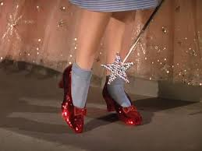
“You had the power all along”
Dorothy doesn’t understand the power she possesses.
She learns of her power in the end of the story.
Look to yourselves for the solution.
The characters pull themselves up
by their bootstraps.
Every character possesses the virtues they doubt.
Scarecrow left in charge of Oz.
There was no Wizard…the people had the power all along…that is what America is all about.

Slide 28
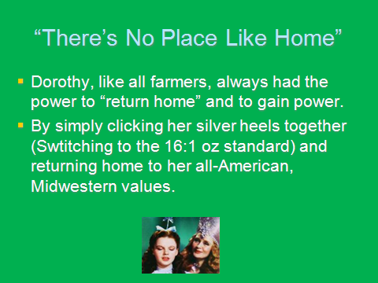

Slide 29
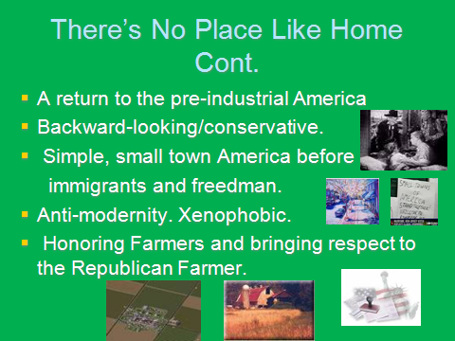

Slide 30
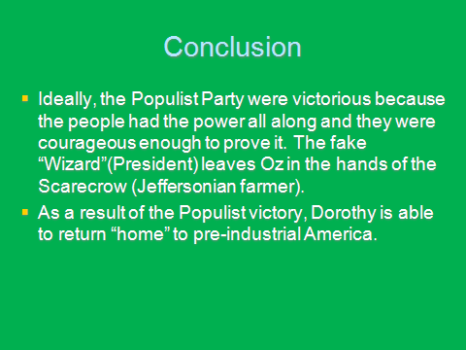
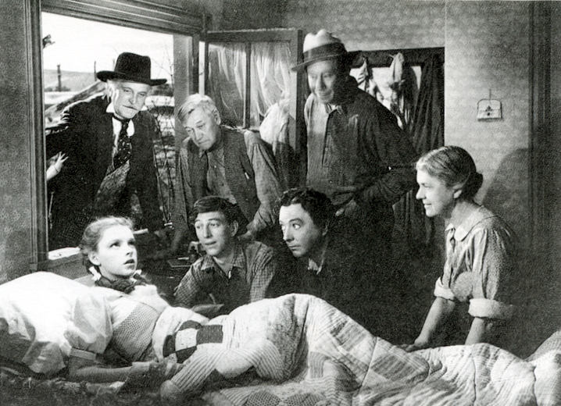

Slide 31


